Slide 1


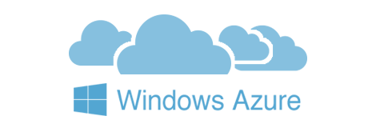

ASP.NET Core Cookbook
Microsoft Azure, Azure Portal, Azure Web Apps Application Deployment
C# MVC Frameworks
SoftUni Team
Technical Trainers
Software University
http://softuni.bg

Slide 2
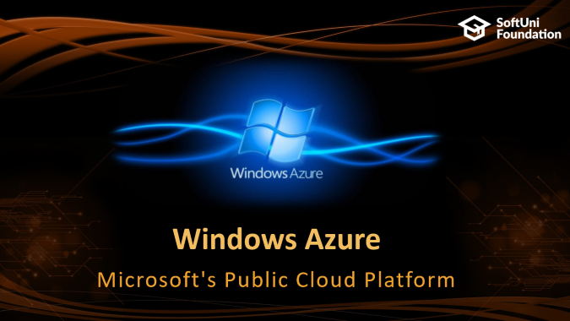
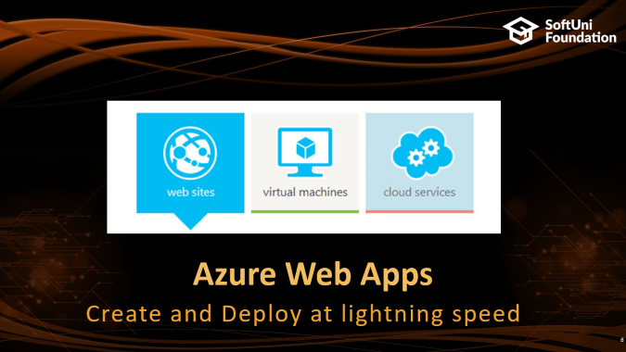
Table of Contents

Slide 3
Questions
sli.do #csharp-web

Slide 4

Windows Azure
Microsoft's Public Cloud Platform

Slide 5
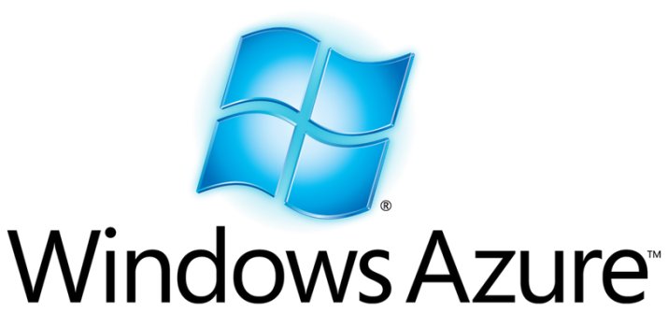
Microsoft Windows Azure
Fast-growing public cloud from Microsoft
Provides rich PaaS platform
Mainly for .NET developers
Provides also Java, PHP, Python, and Node.js APIs
Databases, storage, mobile back-ends, CDN, …
Provides IaaS cloud (Windows VMs)
Has an all-time free account with limited services

Slide 6
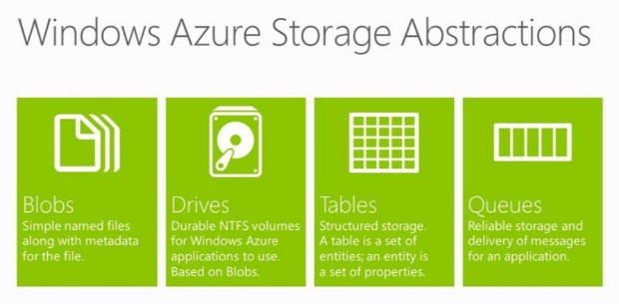
Windows Azure Services
Azure Compute – VMs in the Azure cloud
Storage services
SQL Database – cloud version of SQL Server
Azure Table Storage (NoSQL database)
Azure Queue Storage – message queue services
Azure Blobs / Drives – blob / file storage, NTFS volumes
Azure CDN – content delivery network
Azure Caching – distributed, in-memory, application cache

Slide 7
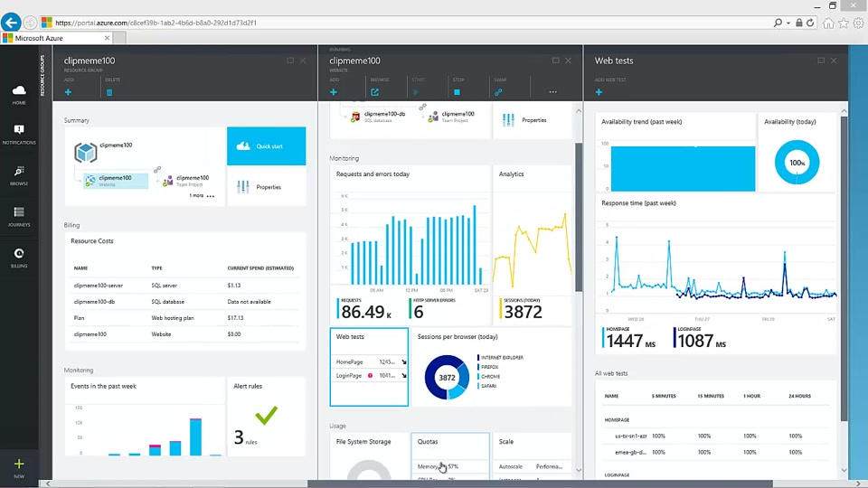
Azure Portal
Live Demo

Slide 8
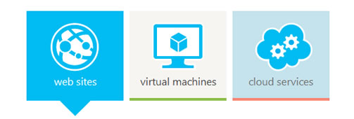
Azure Web Apps
Create and Deploy at lightning speed

Slide 9
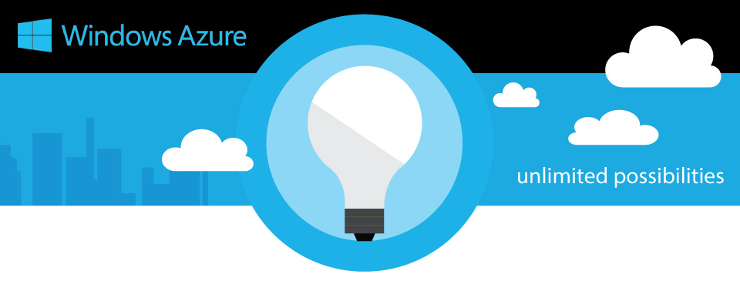
What is Azure Web Apps?
Azure Web Sites is a platform as a service (PaaS)
Cloud computing based platform for hosting websites
Allows publishing web apps written in different platforms
.NET, node.js, Java, PHP, Python

Slide 10
What does Azure Web Apps give us?
Create new sites in seconds
Easily manage and scale your sites
Automatic load balancing and shared storage across instances
Use ASP.NET MVC, ASP.NET Core, PHP, or Node.js, Python ...
Supports any Web development tool on any platform
Windows, OSX, Linux
SQL Azure or MySQL databases

Slide 11
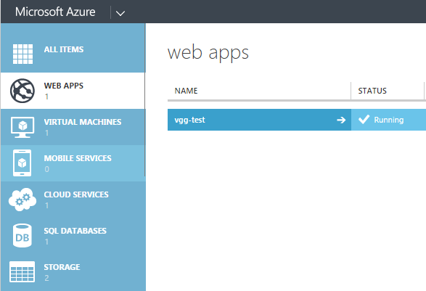
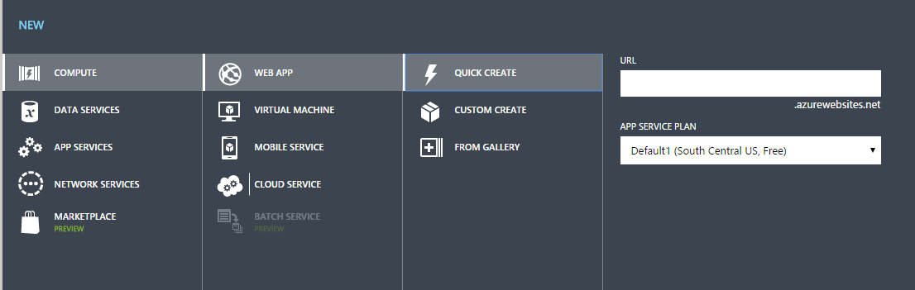
How to deploy application?
Register in Microsoft Azure
Go to Azure Portal
Go to Web Apps
Create new web app
Create new database
Set connection string
Allow Azure IP
Deploy to web app

Slide 12

Azure Web Apps Configuration
You can use .NET, Java, PHP, Python
SSL certificates can be uploaded
SSL bindings to custom domains
Only custom domains can be used
Connection strings can be configured
You can configure Azure Authentication / Authorization
You can scale your web application (cores, memory, instances)
You can add web jobs

Slide 13

Azure Monitoring
You can monitor you application:
CPU Time
Data In
Data Out
HTTP Server Errors
Requests
…

Slide 14
Azure Web Apps
Live Demo

Slide 15

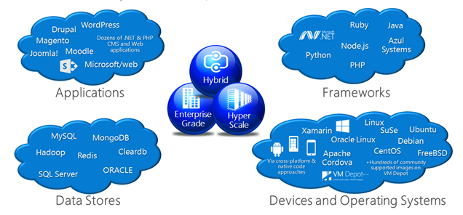
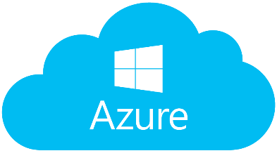
Summary
Microsoft Windows Azure
Set of Cloud Services
Provides Developers with functionality for:
Building Web Apps
Deploying Web Apps
Managing Web Apps
Azure Portal
Azure Web Apps

Slide 16







C# MVC Frameworks – Cookbook
https://softuni.bg/courses/asp-net-mvc

Slide 17
License
This course (slides, examples, demos, videos, homework, etc.) is licensed under the "Creative Commons Attribution-NonCommercial-ShareAlike 4.0 International" license

Slide 18





Trainings @ Software University (SoftUni)
Software University – High-Quality Education, Profession and Job for Software Developers
softuni.bg
Software University Foundation
http://softuni.foundation/
Software University @ Facebook
facebook.com/SoftwareUniversity
Software University Forums
forum.softuni.bg

